Slide 1

Practical steps for creating meaningful scientific figures
Jérôme Hilaire
29 November 2018

Slide 2
“Remember, in science, message and readability of the figure is the most important aspect while beauty is only an option”
Rougier et al. (2014)
“Ten Simple Rules for Better Figures”

Slide 3

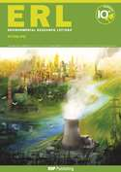
Know your target
“Figures should be in a finished
form suitable for publication. […]“
“Carefully chosen and well-prepared
figures, such as diagrams and
photographs, can greatly
enhance your article. […]“

Slide 4
Figure creation workflow
„ A figure is worth a thousand words.“

Slide 5


Figures as an iterative process
Create

Slide 6

Figures as an iterative process
Create
Discuss

Slide 7
Figures as an iterative process
Create
Discuss

Slide 8

Figures as an iterative process
Create
Enhance
Discuss

Slide 9




2 workflows for 2 figure types
Quantitative figures
(multipanel, labelling)
Create
Enhance
Discuss
Conceptual figures
Discuss
Create

Slide 10
Why use Inkscape?

Slide 11
Why?
Sharpen your message and enhance readibility
Find right figure layout more efficiently
Annotate, add guiding lines with less effort
Create high-quality conceptual figures
(Beautify)

Slide 12
What is Inkscape?

Slide 13
„Inkscape is professional quality vector graphics software which runs on Linux, Mac OS X and Windows desktop computers.“

Slide 14
„Inkscape is professional quality vector graphics software which runs on Linux, Mac OS X and Windows desktop computers.“
“Vector-based files will give us maximum flexibility for sizing your figures properly without losing resolution”
Science (2018)

Slide 15

„Inkscape is professional quality vector graphics software which runs on Linux, Mac OS X and Windows desktop computers.“

Slide 16

Concorde‘s cockpit

Slide 17
The 7 most useful Inkscape functions
Create objects (e.g. lines, paths, rectangles, circles)
Modify objects (e.g. scale, rotate, flip, reshape)
Align and arrange objects
Format objects (e.g. colour, line style)
Export PNG image
Vectorise pixelated images (raster)
Layers

Slide 18

The 7 most useful Inkscape functions
Create objects (e.g. lines, paths, rectangles, circles)
Modify objects (e.g. scale, rotate, flip, reshape)
Align and arrange objects
Format objects (e.g. colour, line style)
Export PNG image
Vectorise pixelated images (raster)
Layers

Slide 19
2 examples

Slide 20
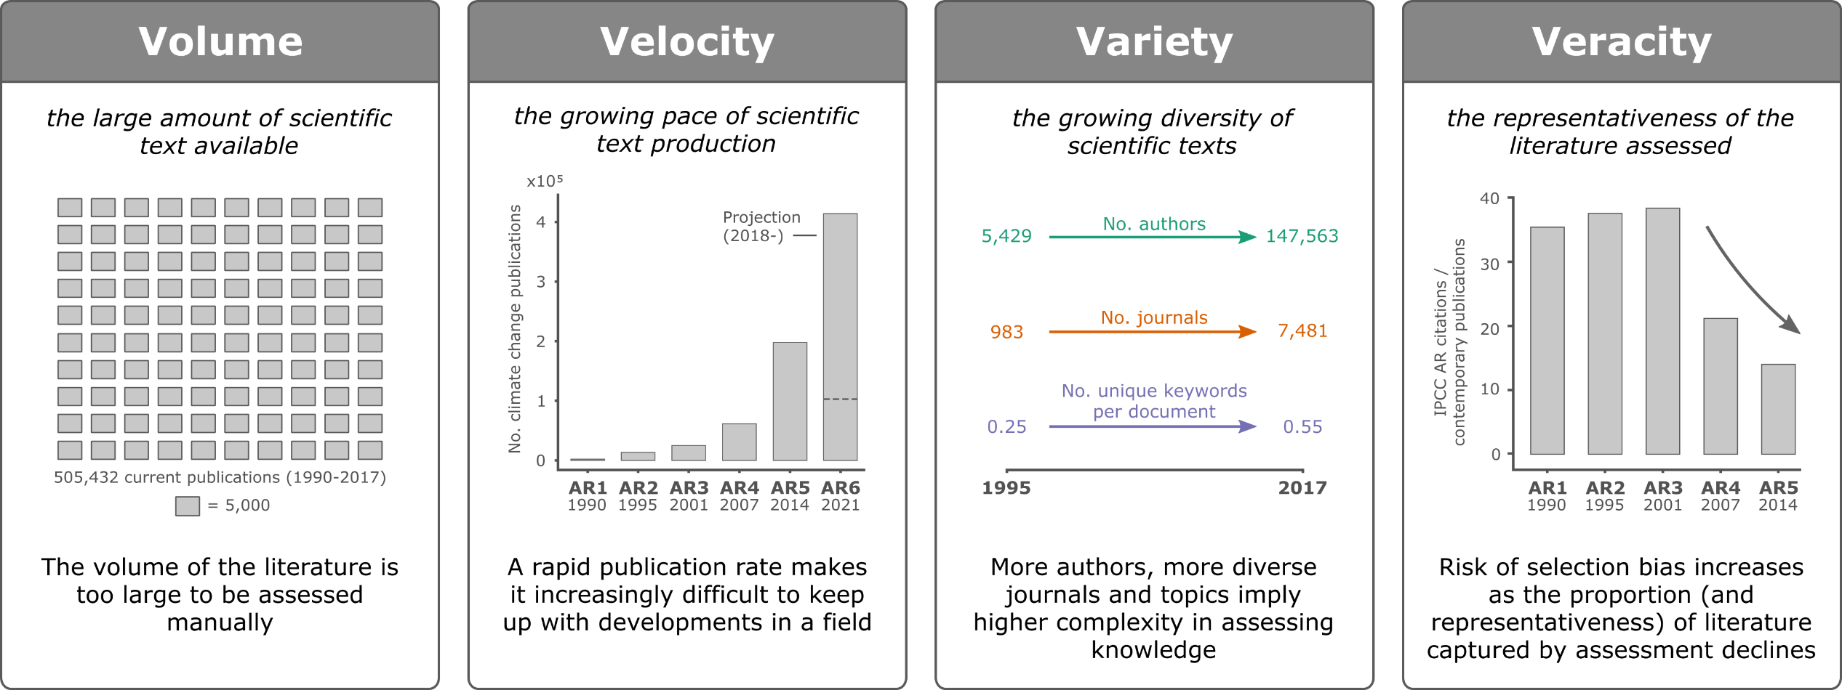
1. Create a high-quality multi-panel figure

Slide 21



2. Vectorise a photo or drawing

Slide 22
Resources
https://www.sciencemag.org/authors/instructions-preparing-initial-manuscript#preparation-of-figures
https://www.nature.com/nature/for-authors/formatting-guide
https://journals.plos.org/ploscompbiol/article?id=10.1371/journal.pcbi.1003833
https://inkscape.org/learn/

